Slide 1
Practice Session 3
List of Desires

Slide 2
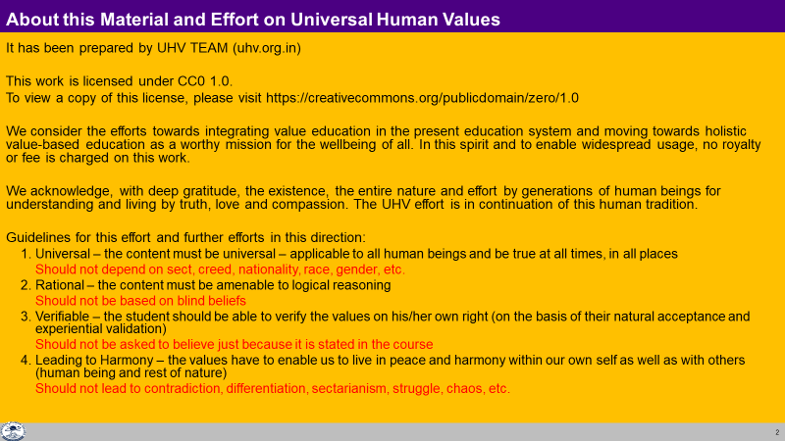

Slide 3
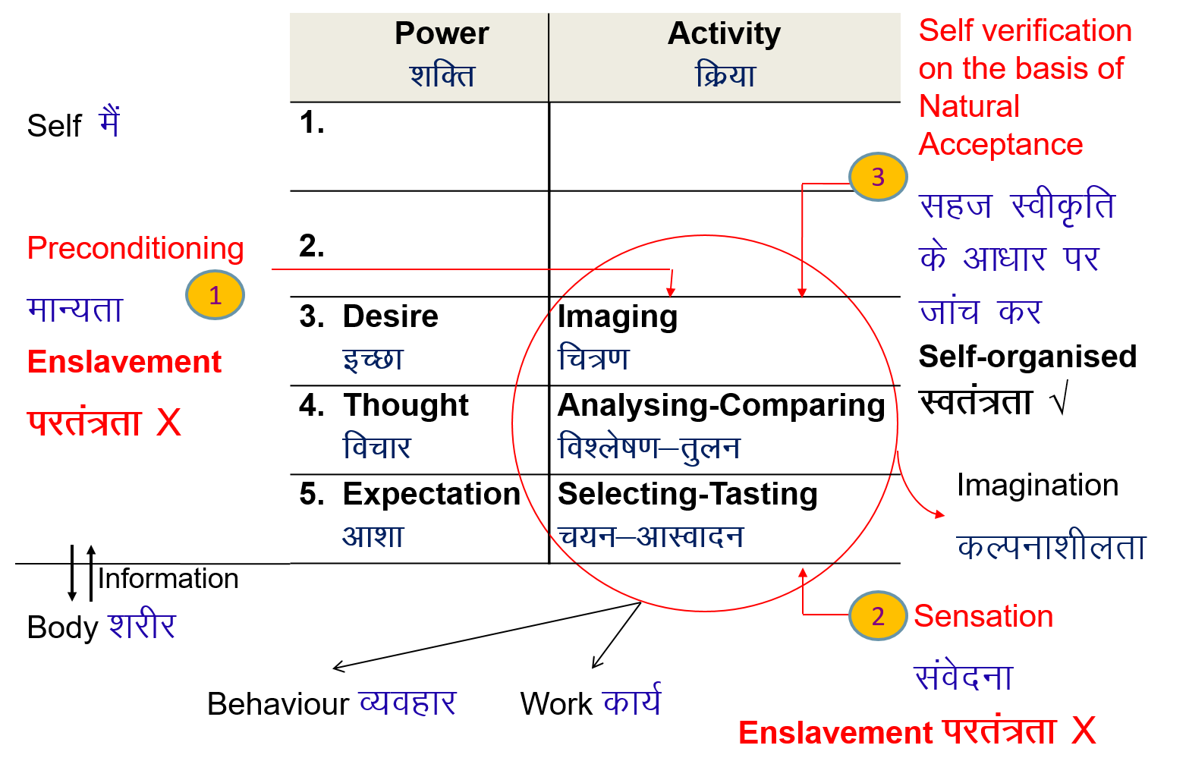
Practical Exercise
Make a list of your desires, thoughts and expectations, i.e. imagination
Then categorize
  By fulfillment
    Physical facility, sensation
    Feeling in relationship or lack of it
    Understanding or lack of it
  By basic need
    Need of Self
    Need of Body
  By the source of motivation
    Preconditioning
    Sensation
    Natural Acceptance

Slide 4
Self Reflection
Make a list of your wants, desires… Find out what is needed to fulfill them:
  – right understanding (clarity)
  – relationship (right feeling – trust, respect … love)
  – physical facility (money…)
eg. right und relationship physical facility, body
Money √ (salary…)
Name, fame, attention √ √ √
good food √ (food)
big car √ (car)
peace of mind √ √ (family & friends)
good health √ √ √
Also find out how much time and effort you put in every day in these 3 areas
eg. right und relationship physical facility, body
work 10 hrs 1 hr (learning) 2 hrs (talking) 7 hrs (salary)
eating 2 hrs 2 hrs
sleeping 8 hrs 8 hrs
other activity 4 hrs 3 hrs (worship, TV) 1 hr (bath, gym etc.)
4 hrs 2 hrs 18 hrs

Slide 5
Self Reflection Conclusions
Analyse your list of your desires… Find out what is needed to fulfill them:
  – right understanding (clarity)
  – relationship (right feeling)
  – physical facility (money…)
eg. right und relationship physical facility, body
Money x (salary…)
But with a base of relationship & right understanding
Good friends x
But with a base of right understanding
Peace of mind x x (right feeling in oneself)
CONCLUSIONS:
The base of right understanding is required for any desire to be fulfilled. The base of right feeling in relationship is required for any desire, where others are involved. Physical facility is required for fulfilment of the needs of the body

Slide 6
1. RU, Rel, PF or anything more?
Find out if your needs can be fulfilled by Right Understanding, Relationship and/or Physical Facility
Eg:
What I am… Right Understanding
Respect… RU + Feeling in Relationship
Nutritious Food… RU + Rel + Physical Facility
Is anything more needed (more than RU, R, PF)?
Is anything redundant (out of RU, R, PF)?

Slide 7
2. Categorize: Need of I and Need of Body
Make a list of Your desires, thoughts & expectations
Categorize them as Need of Self (I) or Need of Body
Some needs will be for both I and for Body – you can reflect on what is the primary need
E.g.
Food
Food for nurturing – need of Body
Food for taste – need if I
House
House for protection – need of Body
House to show others, to get respect – need of I
Q: What is the % of desires that are needs of I, % of needs of Body?
Q: % Effort for PF? % Effort for RU & RF?
Q: Re-evaluate the program to fulfill needs of I. PF can only fulfill needs of the Body

Slide 8
2. Categorize: Needs of I and Need of Body
Human Being = Coexistence of Self (I) and Body
Activities of desire, thought & expectation are going on in the Self (I)
These activities are continuous. I can see this within myself
Some of these are related to needs of the Body and some or related to the needs of the Self (I). We can distinguish between these two
Most of the desires, thoughts & expectations are related to the needs of the self
Most of the effort is for physical facility
More effort on right understanding & right feeling in oneself is required

Slide 9
2. Categorize: Need of I and Need of Body
Some desires are needs of the Body
Most desires are needs of Self(I)
Some effort is for Right Understanding & Relationship
Most of the effort is for Physical Facility
Most of the desires are of needs of Self(I)
Most of the effort is for Physical facility
Physical Facility can fulfill only needs of the Body…
Is there a balance between desire and effort?
What is the effort required to balance this?

Slide 10
2. Categorize: Need of I and Need of Body – Effort
Sanskar (t+1) = Fn [Sanskar (t), Environment (t), Self Exploration (t)]
Proposal
Self Study, Self Verification
  Listening (with comitment, concentration, listening to get the sense in which the speaker is indicating, not comparing with pre-conditioning)
  Self-Exploration (to see the reality indicated by the words, to refer to your natural acceptance)
Right Understanding & Right Feeling in the Self (I)
  Your Desire, Thought, Expectation is guided by your own Natural Acceptance

Slide 11
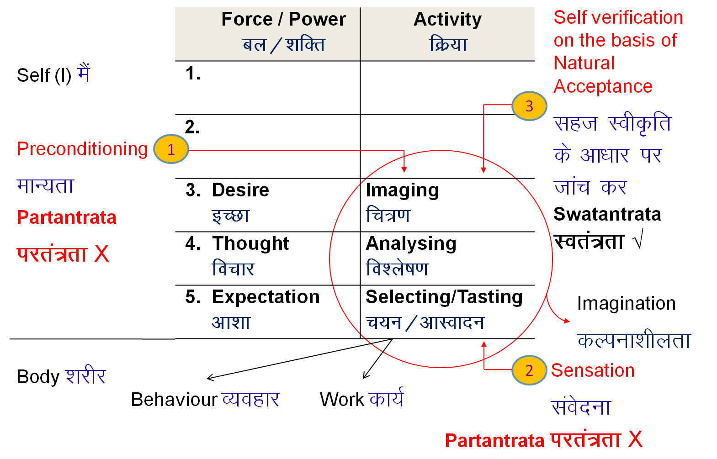
3. Categorise: Preconditioning, Sensation and Natural Acceptance
Take the list of your desires, thoughts & expectations
Categorize them on the basis of their source of motivation: Preconditioning, Sensation or Natural Acceptance
Eg. Nice house
Nice = comparatively better than other houses – preconditioning
Nice = luxurious – sensation
Nice = provides protection
for body
– natural acceptance

Slide 12
3. Categorise: Preconditioning, Sensation and Natural Acceptance
Preconditioning: Assuming without knowing. Depends on something or someone outside, potential to change. Not sure it leads to harmony or contradiction. No continuity of harmony based on preconditioning
Sensation: taste of sound, touch, sight, taste, smell
tasty-necessary → tasty-unnecessary → tasteless-unnecessary → intolerable
Continuity of happiness from sensation is not possible
Natural Acceptance: Purpose or what to be, as a human being.
Leads to harmony (happiness) within, continuity is possible
Natural acceptance is for
Relationship [Mutual fulfillment]
Harmony [Natural characteristic, self-organisation]
Co-existence [Mutual enrichment, complimentartity]
Q: % Preconditioning, % Sensation and % Natural Acceptance

Slide 13

3. Categorise: Preconditioning, Sensation and Natural Acceptance
 | Force / Power cy@“kfDr | Activity fØ;k
1. |  | Realization vuqHko
2. |  | Understanding cks/k
3. | Desire bPNk | Imaging fp=.k
4. | Thought fopkj | Analysis fo'kys"k.k
5. | Expectation vk'kk | Selecting/Tasting p;u@vkLoknu
Self verification on the basis of Natural Acceptance
3
Self-organised
Lora=rk √
Preconditioning
ekU;rk
1
Enslaved
ijra=rk X
Imagination
dYiuk”khyrk
Body 'kjhj
Behaviour O;ogkj
Work dk;Z
2
Sensation
Lakosnuk
Enslaved ijra=rk X

Slide 14
3. Categorise: Preconditioning, Sensation and Natural Acceptance
If most of the Needs are based on Preconditioning or Sensation, then one is living mostly in enslavement (decided by other)
Effort required for self-organisation (living on the basis of your natural acceptance):
Self-awareness – awareness of your desire, thought, expectation
Self-evaluation – evaluation of desire, thought, expectation on the basis of your natural acceptance
If desire is naturally acceptable, it will become definite & continue otherwise it will slowly become corrected or drop off

Slide 15
3. Enslavement and Self-organisation
Preconditioning – Enslavement (Decided by outside, other)
Sensation – Enslavement (Decided by outside)
Natural Acceptance – Self organised
Q: % Enslavement and % Self-organisation

